Slide 1
USAGov and USAGov en español
Laws & Legal Issues Usability Test Report
Digital.gov - November 15, 2022

Slide 2
1/ About the test

Slide 3
Things we wanted to learn
About the test
Primary research goals
Secondary research goals
Assess the rate of task completion
Assess the ease of navigation within topic
Gather first impressions and general design feedback
Assess the tone of the content/site
Explore page title length and wording of left navigation elements
What is clickable on the page?
What do you think you can do here?
Is this site trustworthy?

Slide 4
About the test
About the test
10 English, and 10 Spanish interviews
Moderated and remote
10 mobile,
10 desktop
30 minutes conversational interviews
Recruited participants from underserved communities
Tested with a beta.usa.gov prototype

Slide 5
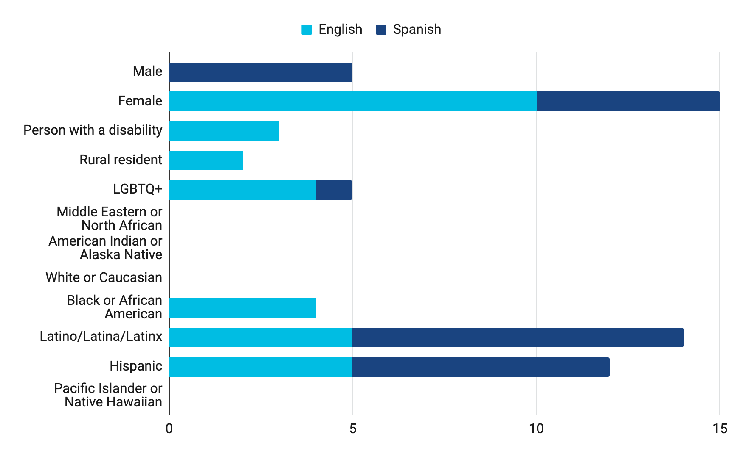
Who participated
About the test
We recruited participants from underserved communities as outlined in Executive Order 13985 of January 20, 2021 (Advancing Racial Equity and Support for Underserved Communities Through the Federal Government).

Slide 6
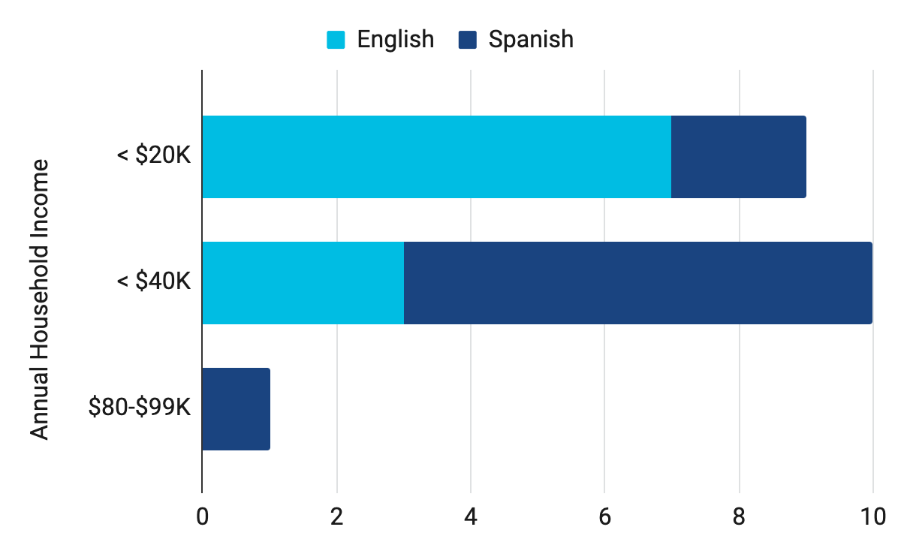
Income (self-reported)

Slide 7
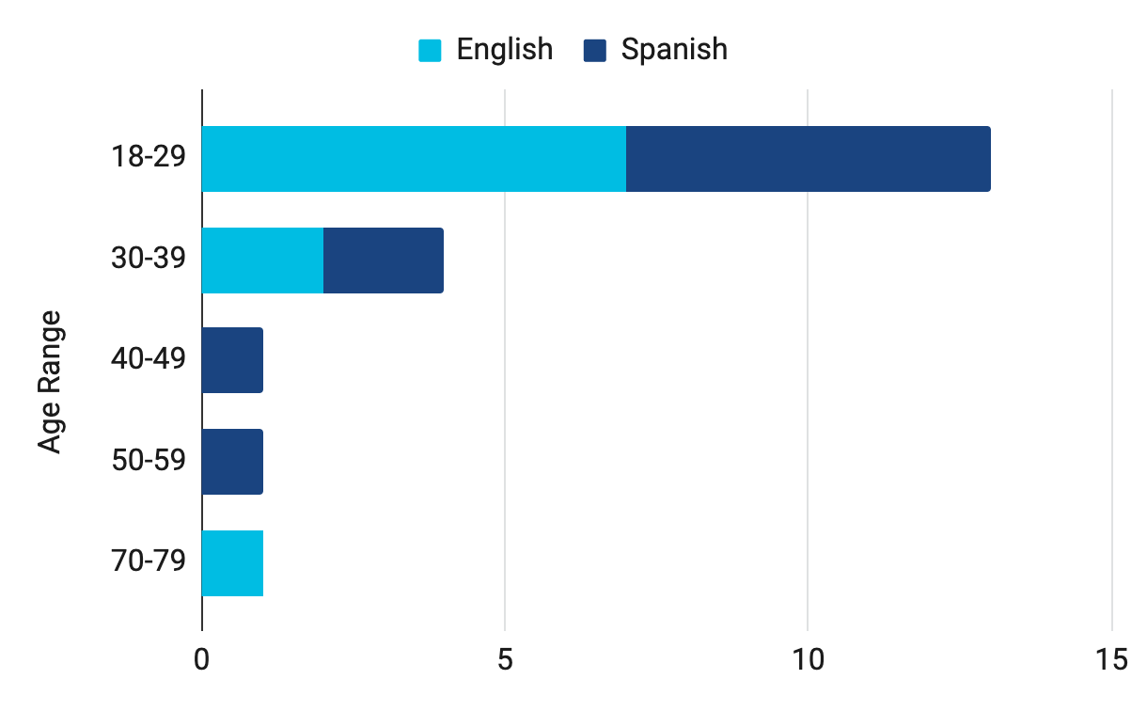
Age Range (self-reported)

Slide 8
2/ Findings

Slide 9
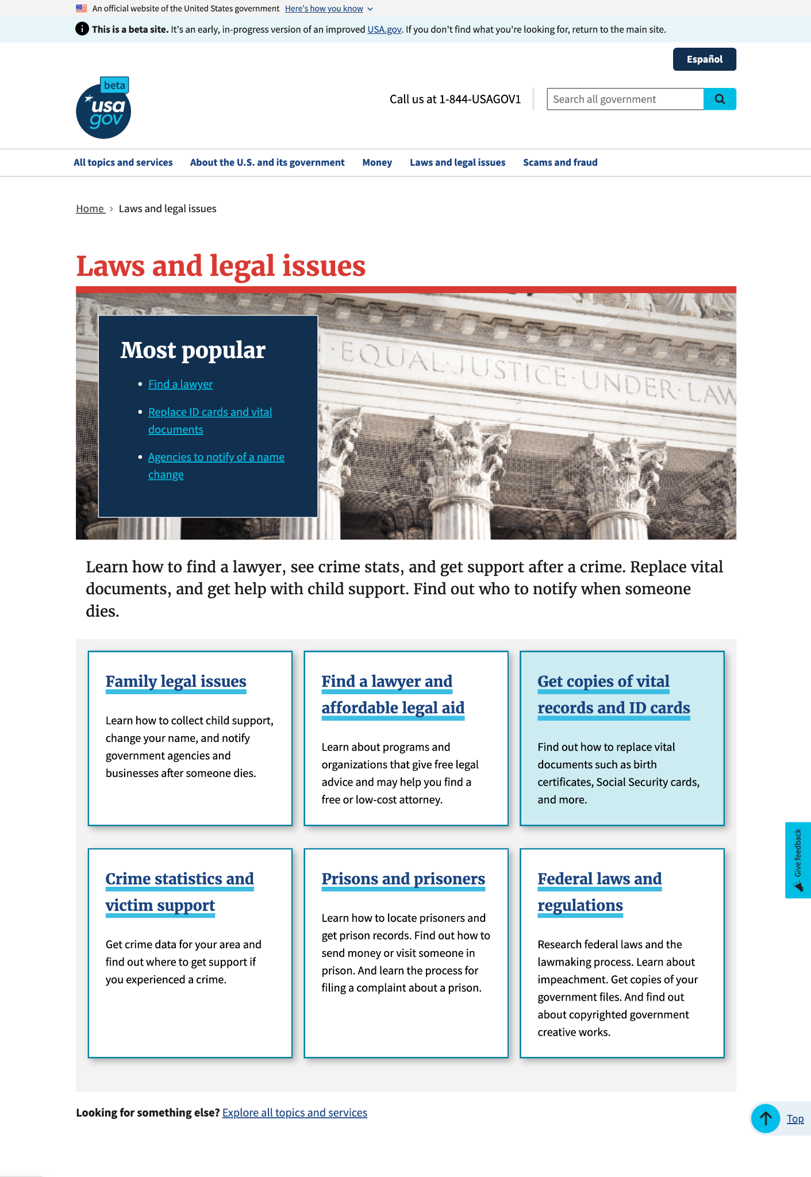
First impressions: Branding
Findings
They knew it’s a government website. How did they know?
USWDS banner
Logo that says “USAGov”
URL
What part of the government? Nobody had any idea.
65% of participants thought it was a legal website.

Slide 10
First impressions: Design feedback
Findings
They said they liked the colors.
They said they liked the large header fonts.
They described the layout as “smooth” and “organized.”
Interactive elements and non-interactive elements were clear.
Participants noted that the “most popular” box stood out.
Feedback on accordions and tables was positive, especially the table.

Slide 11
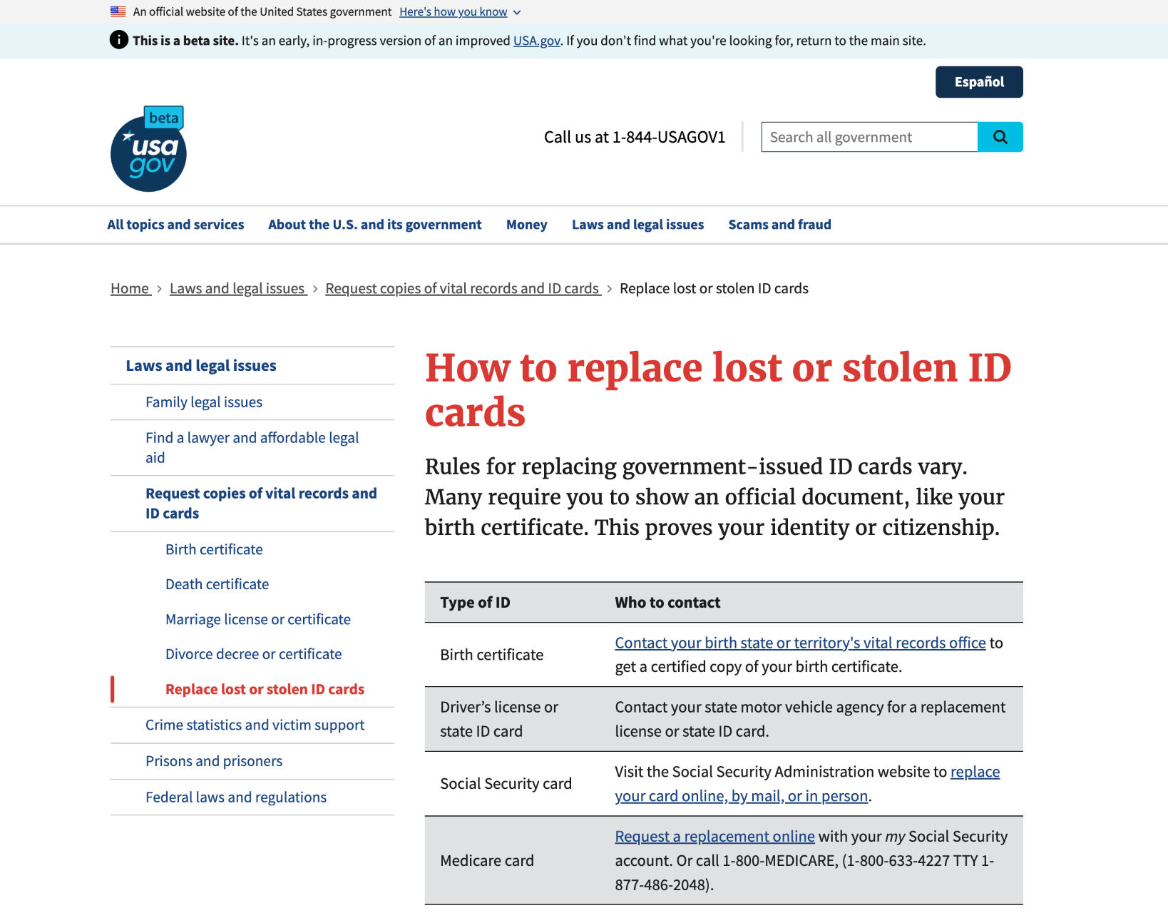
Comments about the table component
Findings
Participants interacted with the “How to replace lost or stolen ID cards” table.
“I love the little grid explaining what I'm looking for.”
“This table is really nice because it kinda breaks it down, ok what type of ID instead of long paragraphs. This is helpful visually.”

Slide 12
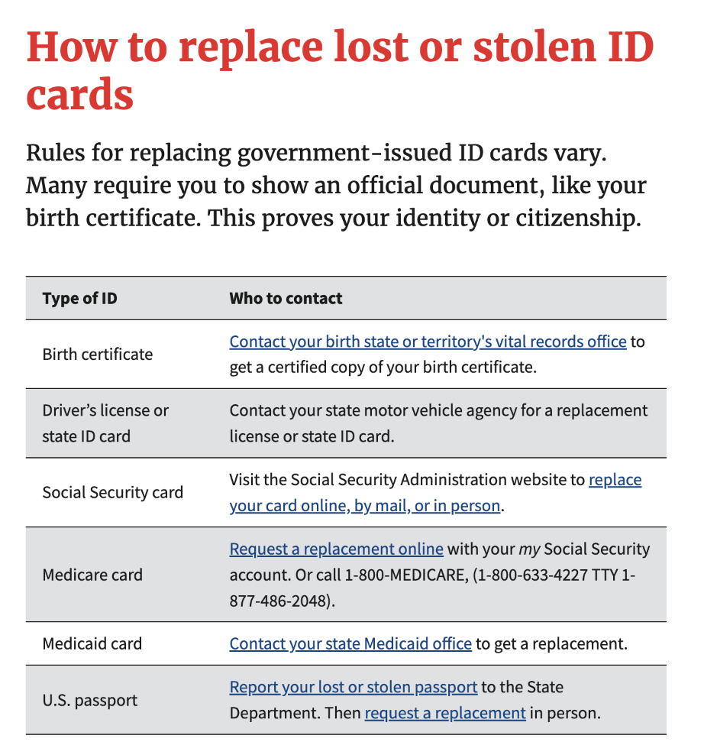
Comments about the table component (cont’d)
Findings
Participants interacted with the “How to replace lost or stolen ID cards” table.
Here we have six different document types. So having them all in a separate table, providing the contact link directly, is a pretty simple and easy way to access that type of contact.
So in my opinion, I think it's excellent. I don't think I would change anything, I think I would leave it as it is, it's super simple and the information is easy to access.”

Slide 13
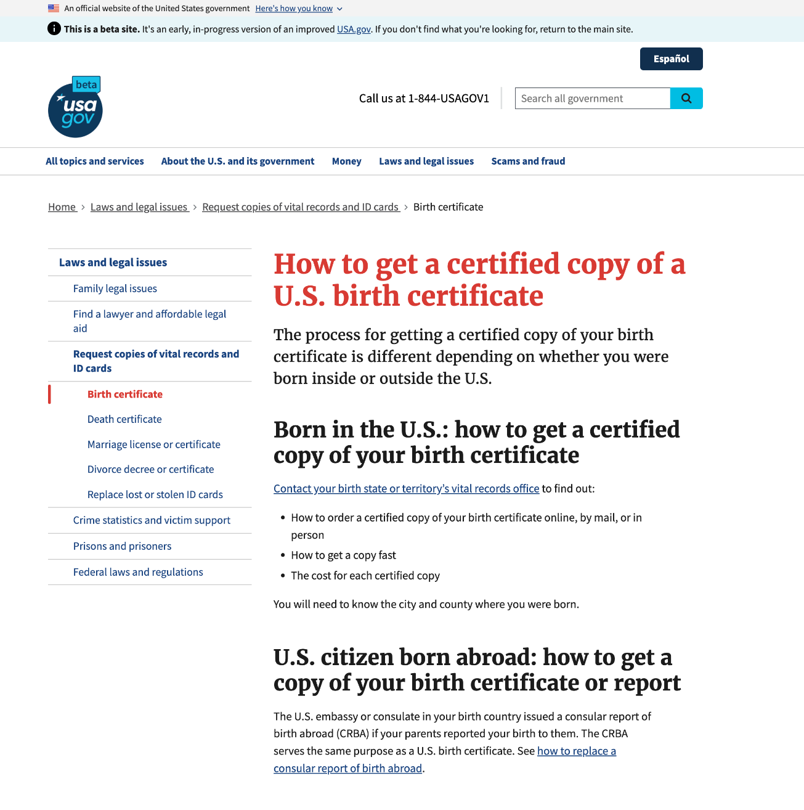
Comments about the design
Findings
“I don't see very well so it's good to know that I can see big letters.”
“When I entered this page I didn't really read the small text, but focused mainly on the large text and found it quite easy and fast to get the desired information.”

Slide 14
Comments about the design (cont’d)
Findings
“Easy to navigate. I'm wondering if there is a negative, but no. Obviously I was limited because I couldn't click the links, but when that all works, at least the layout is very well done.”

Slide 15
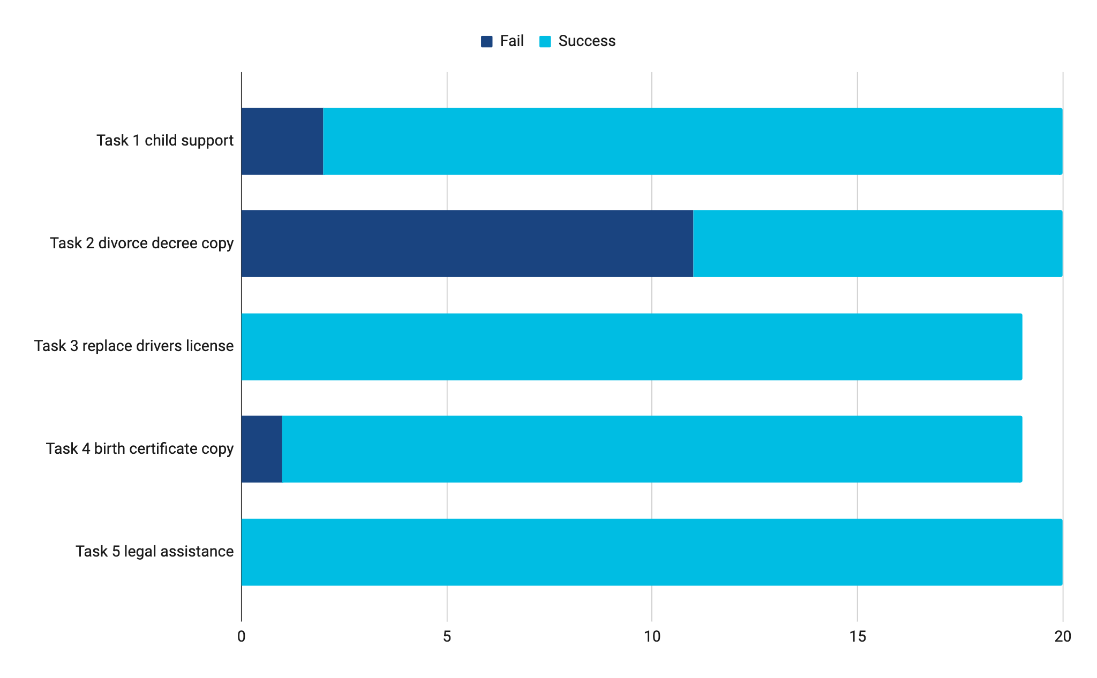
Ease of Task Completion

Slide 16
English ease of navigation within a topic
About the test
Each dot represents a click in the path to complete the task. Mobile participants needed to click around more to get the information they needed.
Task 2
Task 3
Task 4
Task 5
desktop
mobile

Slide 17
Spanish ease of navigation within a topic
About the test
Each dot represents a click in the path to complete the task. Mobile participants needed to click around more to get the information they needed.
Task 2
Task 3
Task 4
Task 5
desktop
skipped task
skipped task
mobile

Slide 18
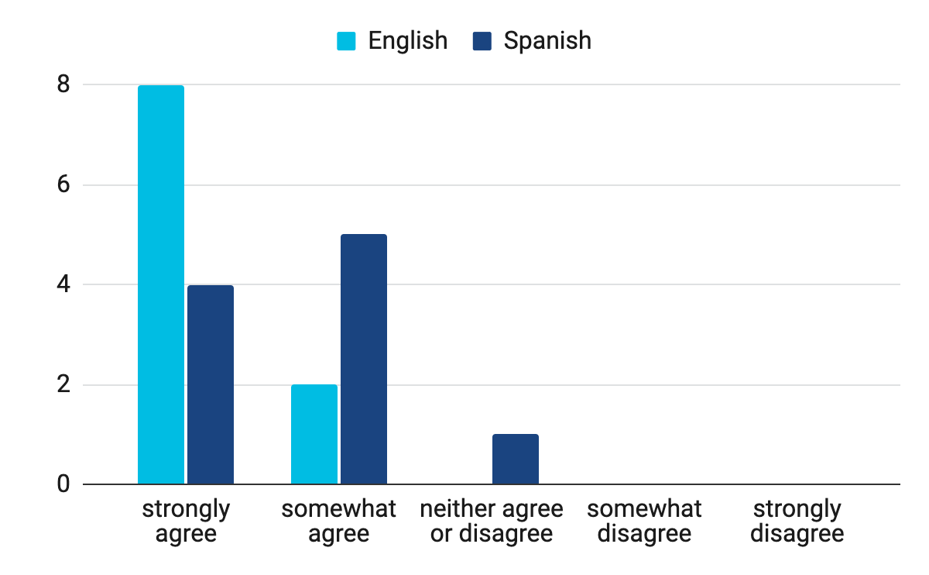
Assessing Tone: Our tone is friendly
Do you agree or disagree with the following statement: I thought this website was friendly.
“Everything was structured and easy to understand so I feel like anyone that would go on the website would be able to understand the words that are there but also the resources provided.”
“I totally agree. I was able to find answers to all your questions immediately so it is intuitive, easy to use.”

Slide 19
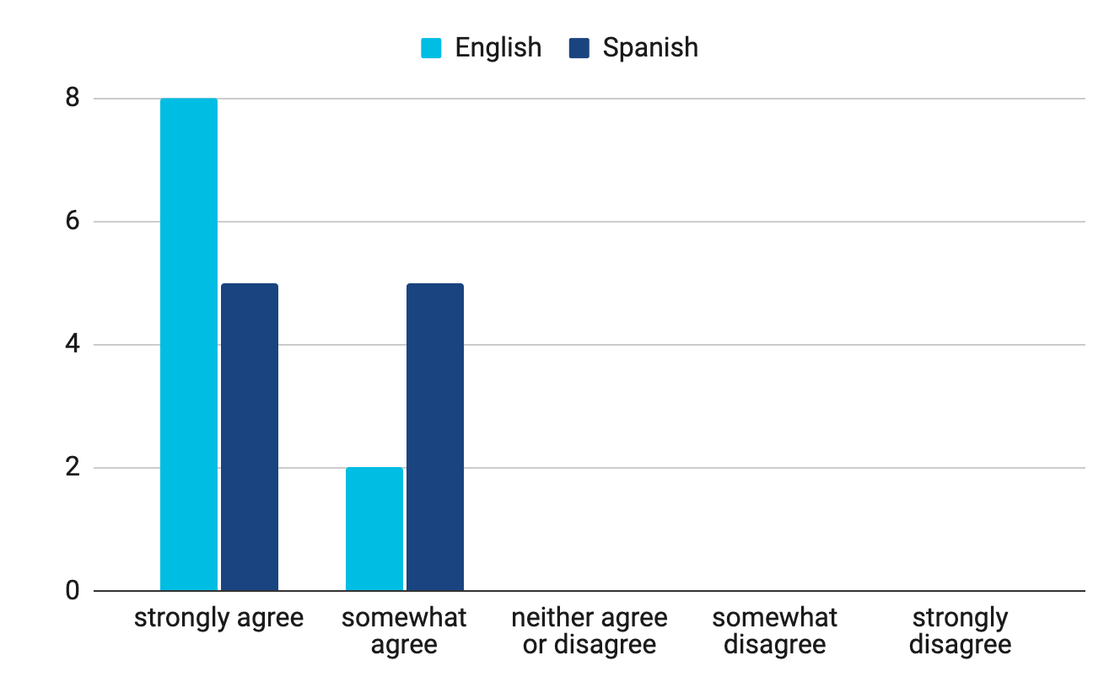
Assessing Tone: Our tone is empathetic
Do you agree or disagree with the following statement: This website showed care and understanding of my situation and needs.
“Español content is very inclusive. Having these resources breaks it down for people who need extra help.”
“Some sites would just have like the link but here it explains everything they have there.”

Slide 20
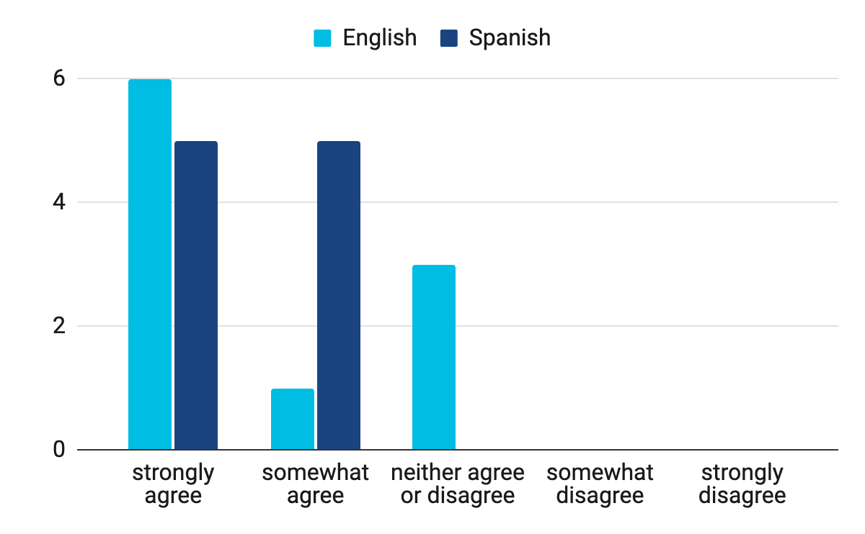
Assessing Tone: Our tone is respectful
Do you agree or disagree with the following statement: This website was respectful.

Slide 21
“ ”
“... the issues that are here are not just about one person or one problem. It's everyone's. It says here free or low-cost legal assistance; they are taking into account that there are people or families that may not have money or may not have the means to pay for a lawyer. So for me that is the most important thing, because it is not only for certain people but for all people. All people can come without feeling like oh you can't help me, or I can't do anything with this.”

Slide 22
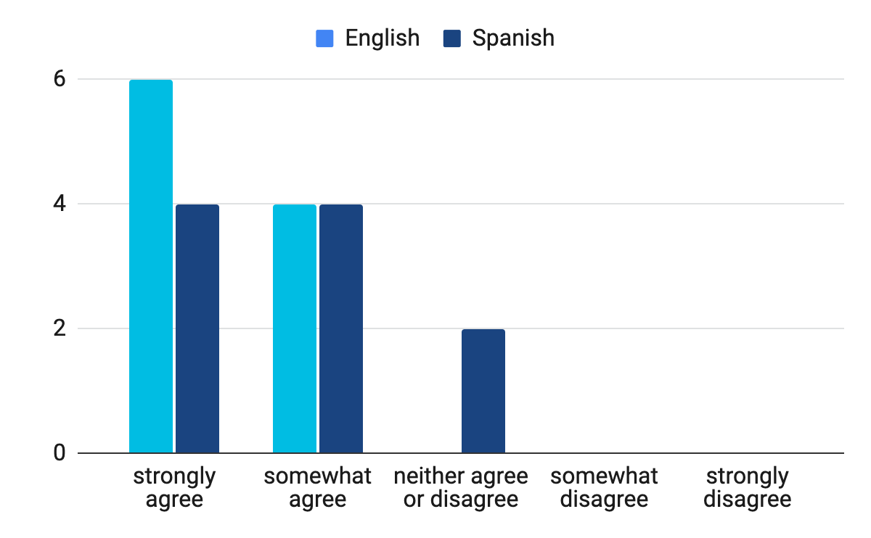
Assessing Tone: Our tone is authoritative
Do you agree or disagree with the following statement: This website can be trusted to be accurate and true.
“Because it's an official government website.”
“You can tell it's a knowledgeable site from knowledgeable, serious people. And what I was also talking about before, visually it looks serious, it doesn't look like a scam or a fraud. It looks like a serious, well-informed site.”

Slide 23
Comments about the content
About the test
“Normally government pages have too much information but this one is quite focused. It really has been the page that I see that is the best designed in that aspect. It is very topic specific so it is short and that makes it easier to use than the average government site.”
“... it seems to me that the information is all there and it is very clear as to how to find it. Really all the headings and subheadings are very clear and say absolutely everything you are looking for.”

Slide 24
Diversity, equity, inclusion, and accessibility (DEIA recruitment reflection)
Findings
We tried, but failed to reach some underrepresented populations with this recruitment. We’ll make adjustments to improve and refine recruitment for our future studies. Some areas for improvement include:
Age range
Groups we missed - Native Americans, Native Alaskans, North Africans, Middle Easterners, Pacific Islanders, Native Hawaiians
People living in persistent poverty
Education
Gender

Slide 25
Comments about the content (cont’d)
About the test
“...to help people who are immigrants or Latino people whose English is not their primary language. Helping them find a lawyer, information about legal assistance, civil registration, etc. A good example would be my mom. She doesn't speak a lot of English.”
“I just wanted to say that I really appreciate that you guys are making this site in Spanish with so much information for people who need it. I know that even for my parents it would be very helpful because they are always confused about how to do things with laws and things like that. I think it is a very good thing what you are doing.”

Slide 26
Thanks!
“They want to help me. That's how I feel about the site.”

